Slide 1
Glycolysis

Slide 2
Graded Quiz Question #1
How does insulin help glucose enter an adipocyte?
Active transport through GLUT1
Active transport through GLUT4
Passive transport through GLUT1
Passive transport through GLUT4

Slide 3
Graded Quiz Question #2
Which enzyme has a Km for glucose near the physiological range:
Glucokinase
Hexokinase
Phosphofructokinase
GLUT4
Notes:
Answer is glucokinase

Slide 4
Graded Quiz Question #3
Which of the following is a target for glucagon dependent regulation in the liver?
GLUT2
PFK1
PFK2
Hexokinase
Notes:
Answer is PFK2

Slide 5
Graded Quiz Question #4
Why is fructose more lipogenic than glucose
It is a disaccharide and therefore has more energy content
It promotes insulin secretion more potently than glucose
Its catabolism skips several metabolic control points
Fructose is primarily metabolized in the adipose tissue

Slide 6
Graded Quiz Question #5
What statement is not true of GALT?
It can be treated by limiting galactose in the diet
It can be treated by ingestion of lactase
Children can be given soy-based formula
Leads to an accumulation of galactose-1-phosphate

Slide 7
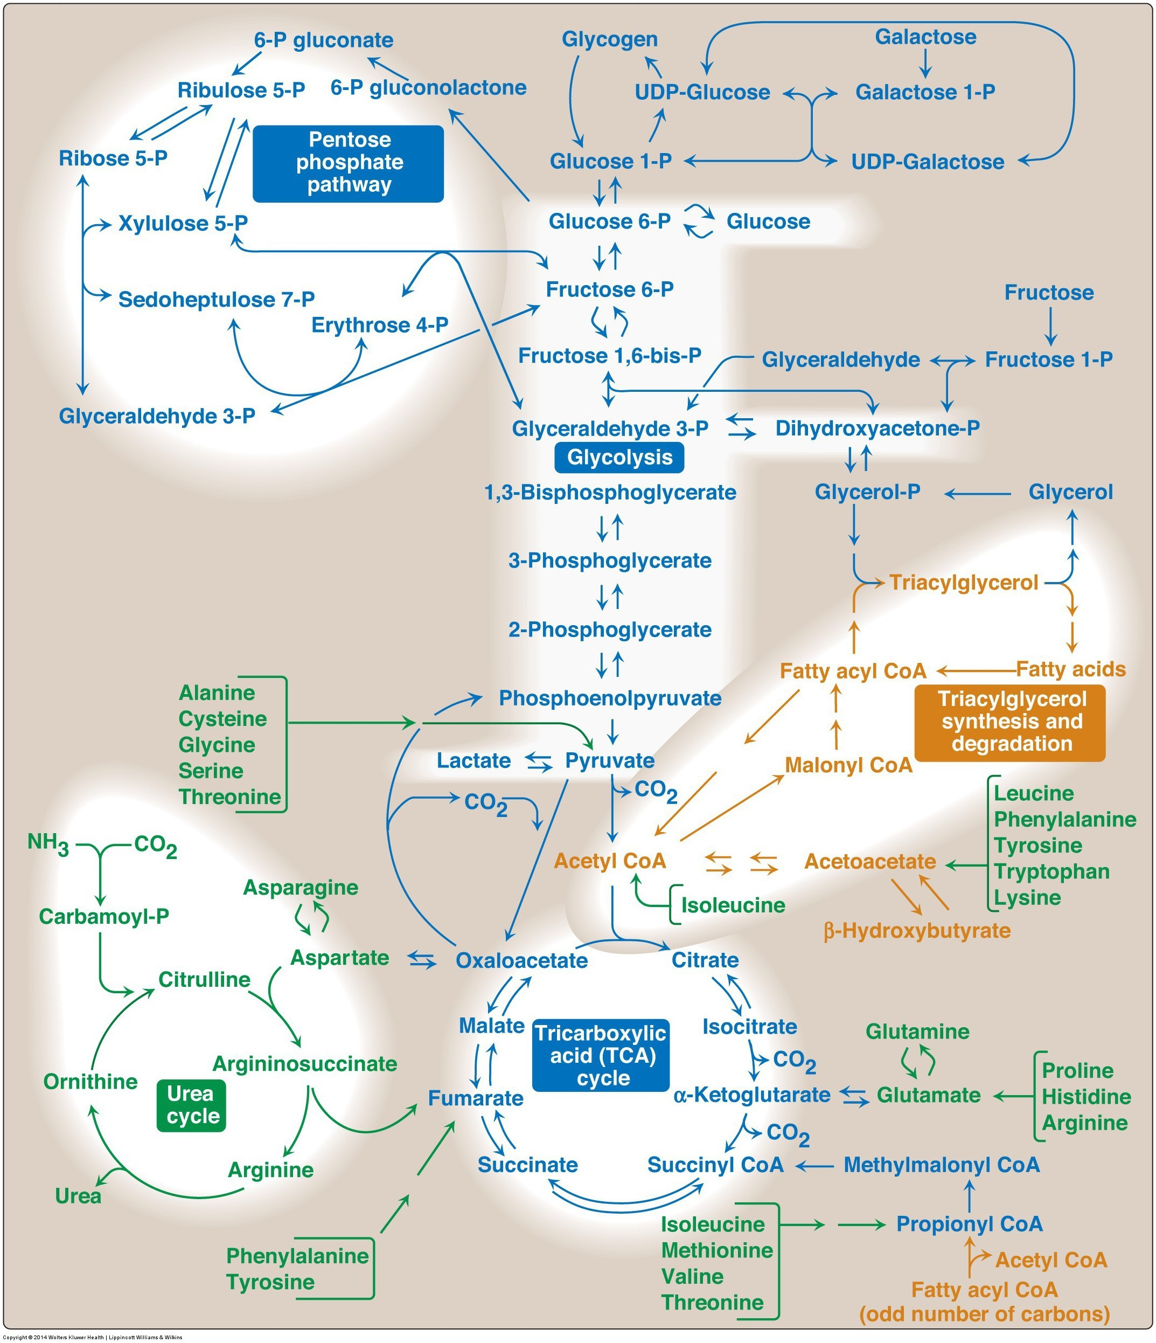
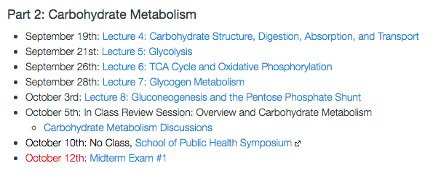
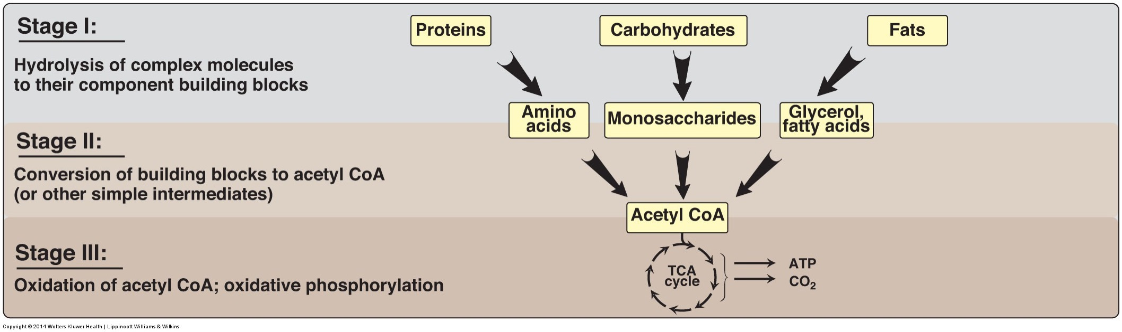
CHO Metabolism Overview

Slide 8
Glycolysis Learning Objectives
Describe the relative roles of glycolysis, gluconeogenesis, the TCA cycle as central nodes of nutrient metabolism.
Explain the enzymatic differences and tissue distributions of glucokinase vs hexokinase and why this is important.
Understand how ATP is produced from glycolysis, and the efficiency of aerobic vs non-aerobic glycolysis
Understand the key points of regulation of glycolysis and how these regulatory points are controlled, notably how glucokinase/hexokinase, PFK1 and PK are regulated including what signals are important in which tissues.
Describe the potential fates of pyruvate, and what dictates the next steps in its metabolism
Explain how non-glucose carbohydrates such as galactose and fructose enter glycolysis, and how their point of entry affects how they are regulated.

Slide 9
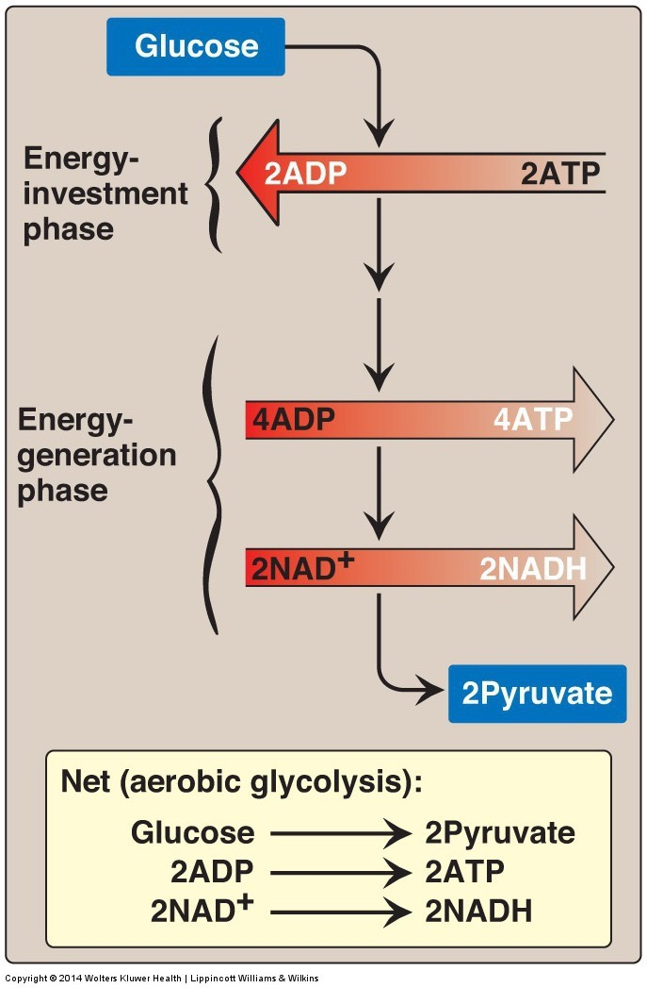
Glycolysis
Main pathway of monosaccharide degradation
Main tissue sites
Liver, muscle
Occurs in cytoplasm of the cell
Glucose conversion to two 3-carbon products: pyruvate

Slide 10
Staring with the End
End product: two pyruvates
Aerobic Conditions
Becomes Acetyl-CoA
In presence of CHO but need energy -> TCA Cycle
In presence of CHO but don’t need energy -> Lipids
In absence of CHO (relevant for lipid oxidation)
Ketone Bodies (if OAA is abasent)
Gluconeogenesis (via pyruvate carboxylase, if Acetyl-CoA is high)
Anaerobic conditions
Becomes lactate
Lactate goes to liver for reconversion back to glucose
Notes:
Absent of CHO is mo

Slide 11
What is Glycolysis Accomplishing?
Think about muscle, liver and fat.
When would we want to activate or inactivate glycolysis in these tissues. Is it always the same?

Slide 12
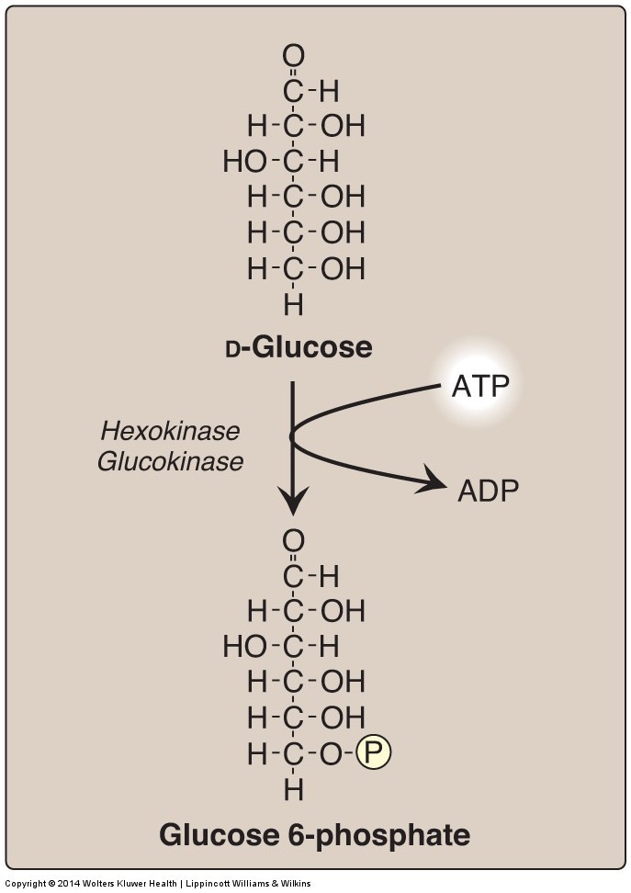
Generating Glucose-6-Phosphate
Traps glucose in the cell
Consumes ATP
Reversible by Glucose-6-Phosphatase (in liver)

Slide 13
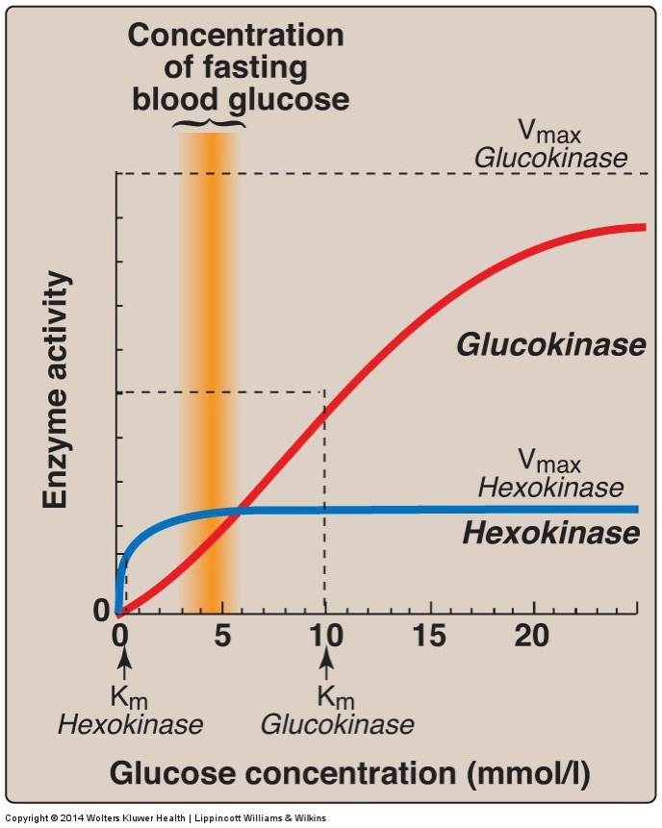
Glucokinase vs Hexokinase
Enzyme | Tissue | Regulation | Kinetics
Glucokinase | Liver/Pancreas |  | Co-operative/Fast
Hexokinase | Fat/Muscle | -G6P | High Affinity
What is the advantage of these different kinetics in these tissues?

Slide 14
Activity – Glucokinase and MODY
Work in groups on these questions
MODY: Mature-Onset Diabetes of the Young
Monogenic form of Type 2 Diabetes
Segregated with Inactivating mutations in GCK (Froguel et al. Nature 1992, Hattersley et al. Lancet 1992)

Slide 15
Pedigree
Affected Male
Question 1: Is this a dominant (A) or recessive (B) trait?
Enter your answer with your iClicker
Affected Female

Slide 16
What is the mechanism?
Glucokinase is expressed in beta cells (A), and in liver cells (B). Which seems more likely to be causing MODY?

Slide 17
Typical Pathophysiology
Velho, G. et al. Identification of 14 new glucokinase mutations and description of the clinical profile of 42 MODY-2 families. 217–224 (1997).

Slide 18
What is going on?
What are the significant differences between subjects with MODY (GCK variants) and without?
Are the islets more (A) or less (B) sensitive to glucose levels?
Draw a curve estimating glucokinase activity vs glucose levels in normal and MODY subjects.

Slide 19
An activating variant in GCK
Familial
Hyperinsulinemia
Hypoglycemia
Hyperinsulinemia
MODY

Slide 20
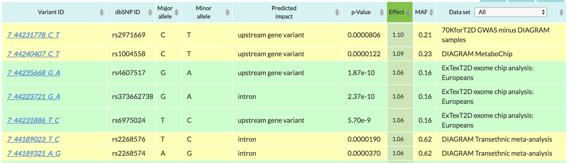
Common Variants in GCK
MAF: Mean allele frequency (0-1), is how common this variant is
Effect: 1.10 means 10% increase in risk of Type 2 diabetes
http://www.type2diabetesgenetics.org/gene/geneInfo/GCK

Slide 21
Fates of Glucose-6-Phosphate
GS: Glycogen syntase
PFK1: Phosphofructokinase 1
G6PDH: G6P Dehydrogenase

Slide 22
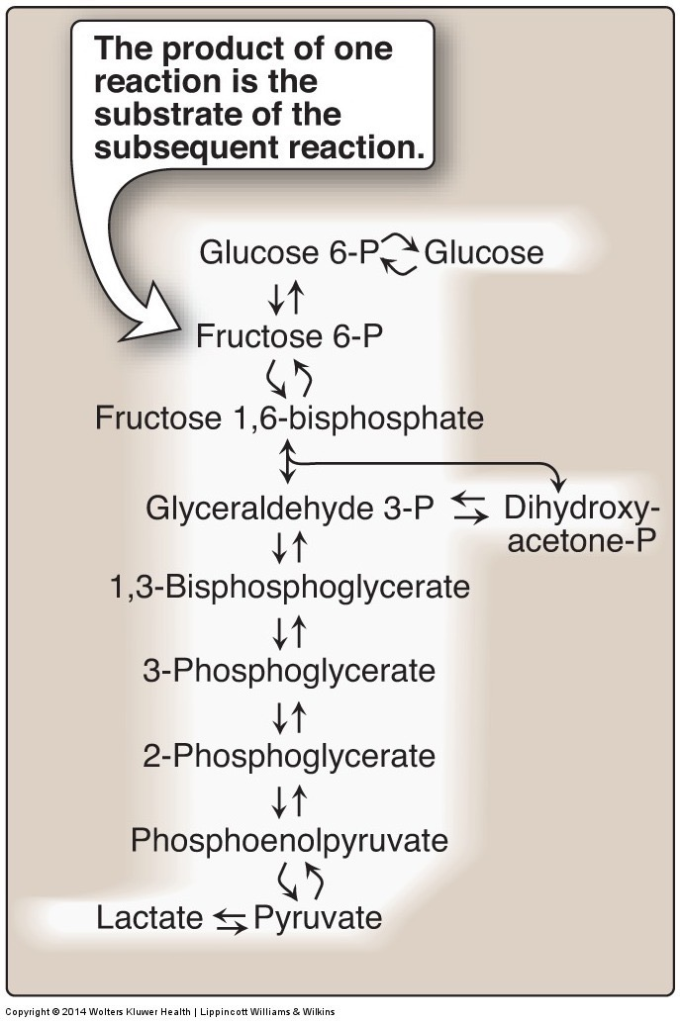
The Next Regulated Step is PFK1

Slide 23
Tarui’s Disease
Heritible loss of the PFK1 isoform in Muscle (PFKM)
Symptoms include
Muscle weakness
Increased glycogen in muscle
Myopathy
Possible treatments?

Slide 24
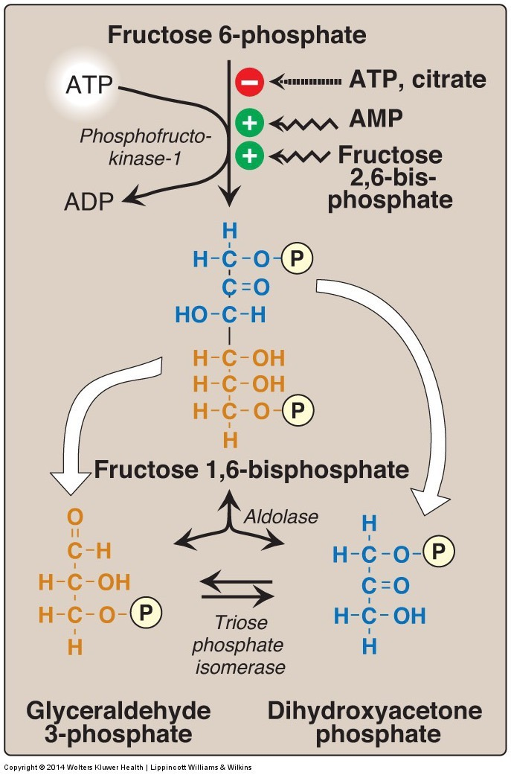
Regulation of PFK1
Priority of regulators
F26bP
AMP
ATP
Citrate

Slide 25
Allosteric Regulation of PFK1
F6P is held constant here
Mansour TE. Studies on Heart Phosphofructokinase : Studies on Heart Phosphofructokinase : Inhibition , and Activation. J. Biol. Chem. 1963;238(7):2285–2292.

Slide 26
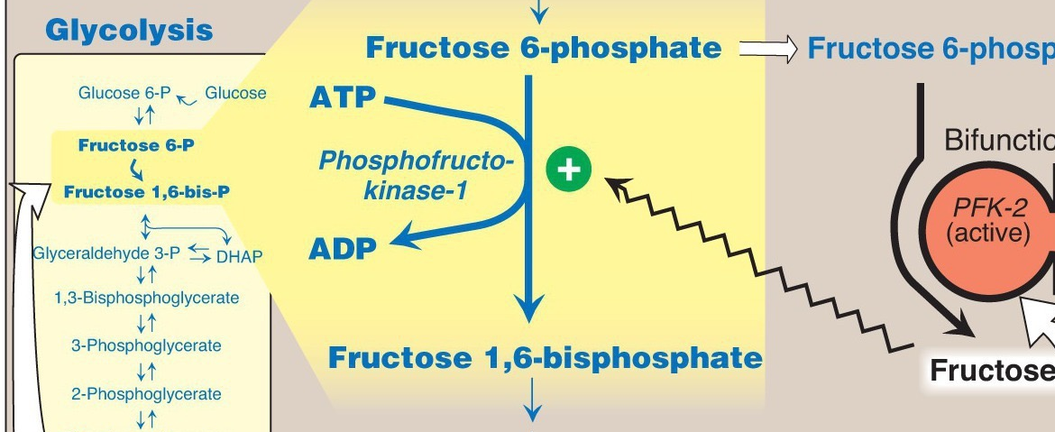
Regulating the Regulator
Fructose-2,6-bisphosphate

Slide 27
Regulating the Regulator of the Regulator

Slide 28
What is the point of all this?
Buildup of TCA cycle intermediates can slow glycolysis (Citrate)
That can be over-ridden by energy needs (ATP/AMP)
BUT glucose flux can over-ride energy needs (F26bP)
AND hormones can over-ride glucose flux (PFK2 inhibition, reducing F26bp)

Slide 29
How does glucagon/adrenaline inhibit PFK-2 activity in liver not muscle
Muscle doesn’t have PFK-2 activity
Glucagon/Adrenaline do not activate PKA in muscle
Muscle PFK-2 can’t be phosphorylated by PKA
There are no Glucagon/Adrenaline receptors in muscle

Slide 30
Tissue Specificity in PFK2 Regulation
Glucagon/Adrenaline can phosphorylate and inhibit Liver PFK2 but not Muscle PFK2
PFK-2 isoforms
Pourquoi?

Slide 31
The third regulated step in glycolysis is Pyruvate Kinase
Substrate mediated ADP phosphorylation
Notes:
Other example of substrate mediated phosphorylation is phosphoglycerate kinase

Slide 32
How is Pyruvate Kinase Regulated

Slide 33
Post-Translational Regulation of Pyruvate Kinase
Alanine inhibition only in liver

Slide 34
What would PFK2 deficiency do to Pyruvate Kinase Activity
Increase it because of less Fructose-1,6-bisphosphate
Decrease it because of less Fructose-1,6-bisphosphate
Increase it because of less Fructose-2,6-bisphosphate
Decrease it because of less Fructose-2,6-bisphosphate

Slide 35
Tissue Specific Regulation of Glycolysis Summary
Component | Liver | Muscle
Glucokinase/Hexokinase | Not inhibited by G6P | Inhibited by G6P
Phosphofructokinase | Inhibition of PFK-2 (regulates via F26bP) | PFK-2 not inhibited by phosphorylation
Pyruvate Kinase | Inhibition of PK by alanine and by phosphorylation | PK not inhibited by alanine or phosphorylation

Slide 36
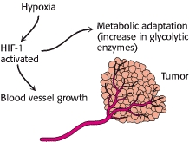
Transcriptional Regulation of GK/HK, PFK1 and PK Promotes Glycolysis
Hypoxia (HIF)
Carbohydrate sensing (ChREBP – L-PK)
Chronic glucagon (CREB - GK)

Slide 37
Glycolysis Net ATP
Note: NADH is energy equivalent to 3 ATP (from the ETC)
Energy Consuming Reactions:
Reactions 1: 1 ATP
Reaction 3: 1 ATP
Energy Generating Reactions:
Reaction 6: 1 NADH x 2 (3 ATP x 2 = 6 ATP)
Reaction 7: 1 ATP x 2 (2 ATP)
Reaction 10: 1 ATP x 2 (2 ATP)
Net Energy Gain:
4 ATP + 2 NADH minus 2 ATP = 8 ATP generated from glycolytic breakdown of glucose

Slide 38
TCA Cycle Net ATP

Slide 39
Energy Stress and Glycolysis
We have discussed 2 ways in which elevated low energy can activate glycolysis, do you remember what they are?
AMPK can regulate glycolysis, think of an example of how it could do this

Slide 40
Fructose and Galactose

Slide 41
Liver Fructose Metabolism
5
Skips the regulatory steps of Glucokinase and PFK2

Slide 42
Fructose Consumption and Metabolic Health

Slide 43
Inherited Disorders of Fructose Metabolism
Fructokinase mutations
Fructose not trapped in the cell
Elevated fructose in the blood
Generally not pathological
Aldolase B mutations
Buildup of Fructose-1-phosphate
Impaired gluconeogenesis and glycogenolysis
High risk of hypoglycemia
What if fructokinase made Fructose-6-phosphate (it dosent)? How would that affect glycolysis?

Slide 44
Fructolysis Summary
Fructose glycolysis in liver begins with FK
Bypasses two important regulatory step in glycolysis
Reaction 1 (glucokinase/hexokinase)
Reaction 3 (phosphofructokinase)
Pyruvate products may be shifted to pathways involved in fatty acid or cholesterol synthesis
Outside the liver hexokinase can phosphorylate Fructose to make F6P, but this is very inefficient

Slide 45
Galactolysis
GALT
These will come up again when we talk about Glycogen Metabolism in a couple lectures

Slide 46
Galactolysis Summary
Galactose kinase phosphorylates galactose to galactose 1-phosphate
Galactose 1-P is coverted to Glucose 1-phosphate
G1P has different fates dependent on energy needs:
Glycogenesis
Glycolysis

Slide 47
Glycolysis Learning Objectives
Describe the relative roles of glycolysis, gluconeogenesis, the TCA cycle as central nodes of nutrient metabolism.
Explain the catalytic differences and tissue distributions of glucokinase vs hexokinase and why this is important.
Understand how ATP is produced from glycolysis, and the efficiency of aerobic vs non-aerobic glycolysis
Understand the key points of regulation of glycolysis and how these regulatory points are controlled, notably how glucokinase/hexokinase, PFK1 and PK are regulated including what signals are important in what tissues.
Describe the potential fates of pyruvate, and what dictates the next steps in its metabolism
Explain how non-glucose carbohydrates such as galactose and fructose enter glycolysis, and how their point of entry affects how they are regulated.

